Slide 1
Cloud | Artificial Intelligence
AI/ML Powered by Cloud !!!

Slide 2

Our focus for Today
mission
Cloud Providers to Democratize Machine Learning
Agenda
ML at Amazon.com
Why AI on AWS
Amazon ML stack
Different AI services
Amazon Sagemaker

Slide 3

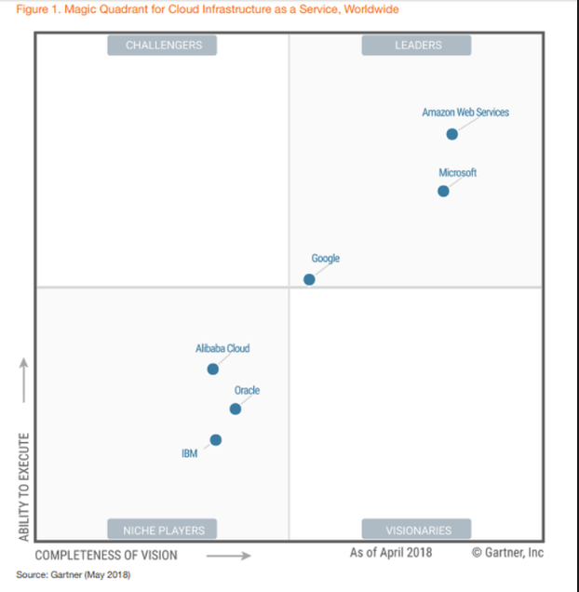
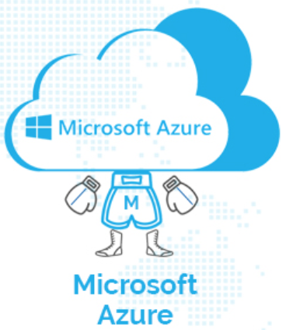

Top cloud service provides

Slide 4
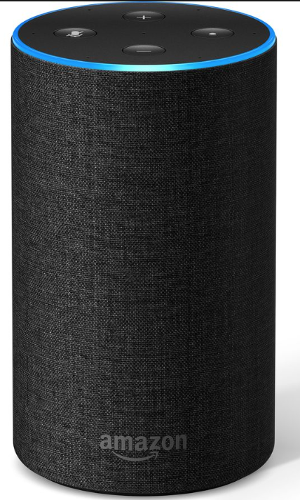
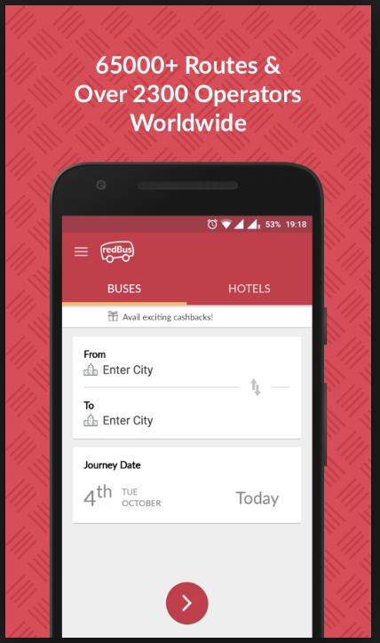



Redbus + AWS use case
Me :- Alexa, please book a ticket from Bangalore to Mumbai
Alexa :- Please suggest a date and time
Me. :- 15th August 2019 ko Dus baje.
Alexa. :- Ok, ticket will be booked for 15/08/2019 10:00 AM, please confirm.
From a concept to production
4 Hrs.

Slide 5






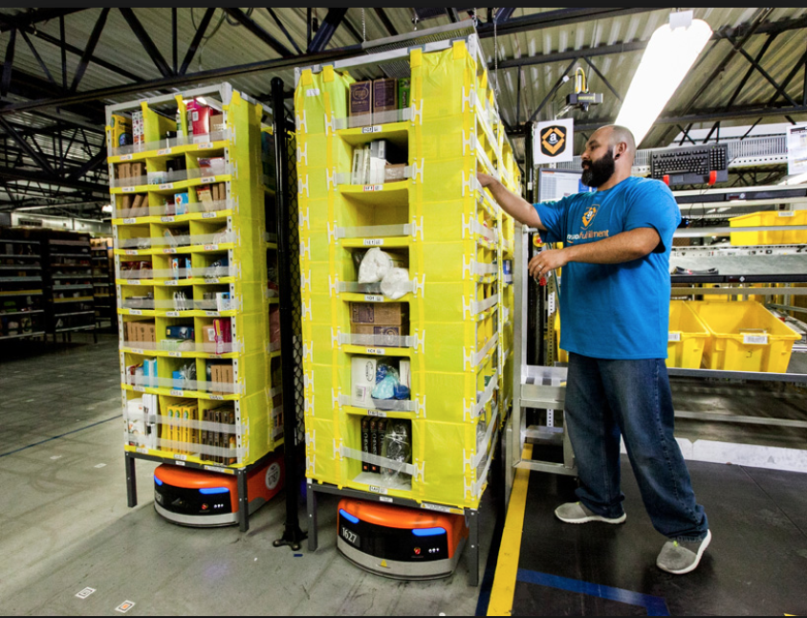
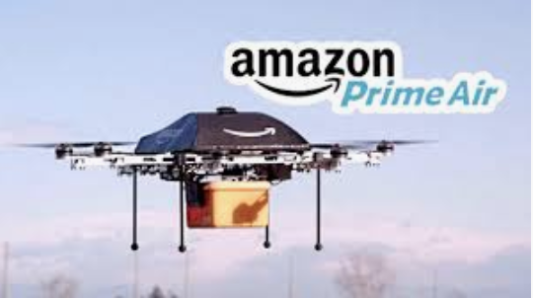
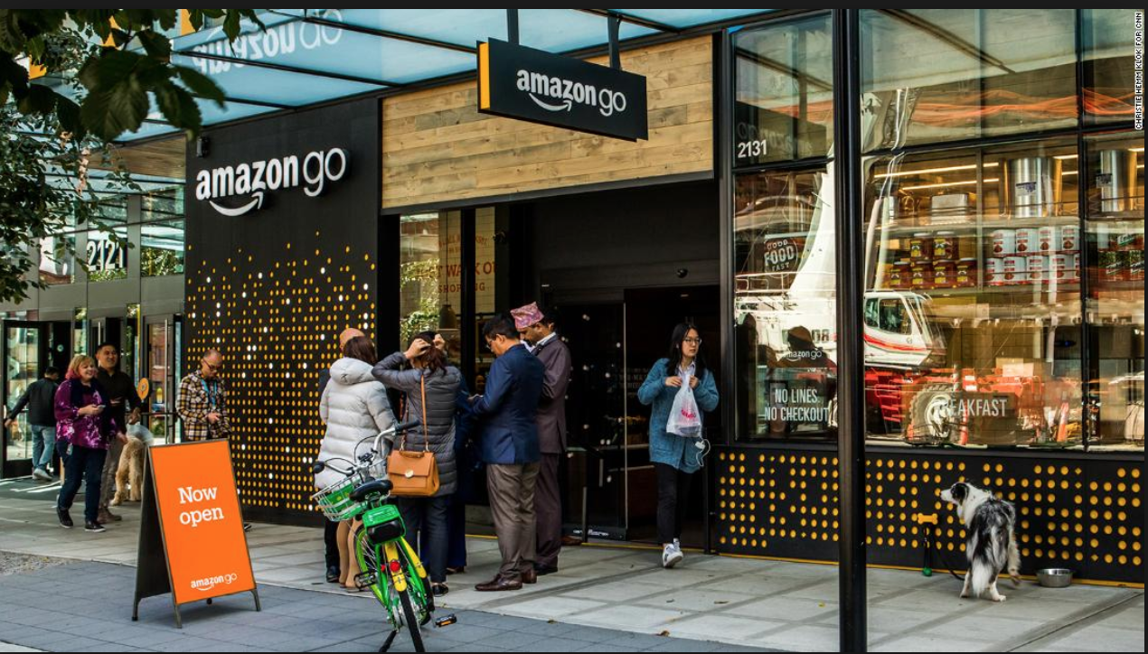
Machine Learning at Amazon.com
Personalized recommendations
inventory management
Drones
Voice driven interactions
Inventing entirely new customer experiences

Slide 6
Why AWS for AI?
Wide variety of AI and ML services for your business
Low cost and ease of use
support for the all popular frameworks
Wide variety of HPC machines

Slide 7
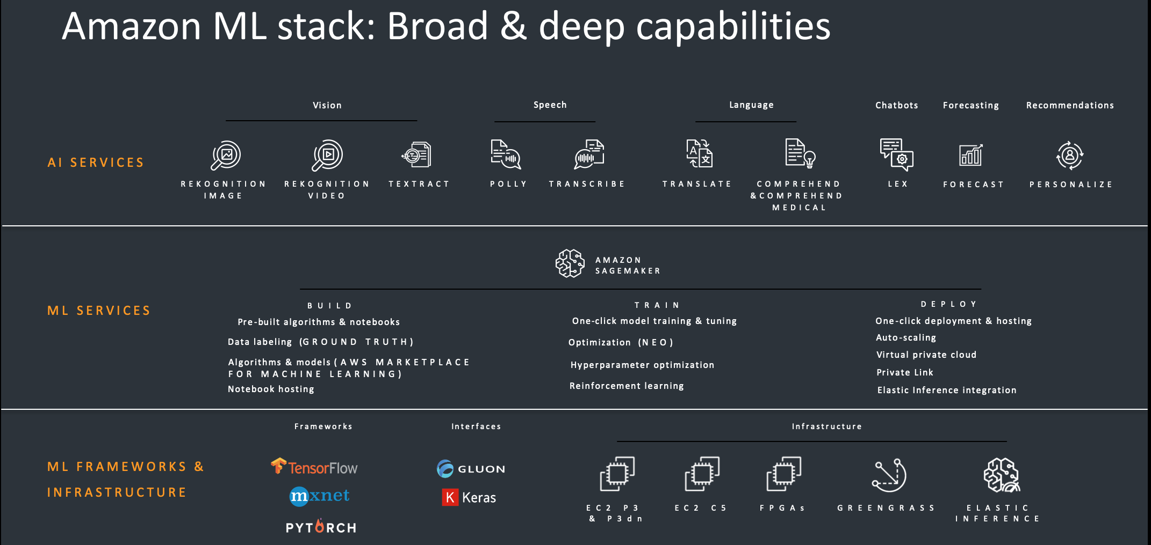

Slide 8
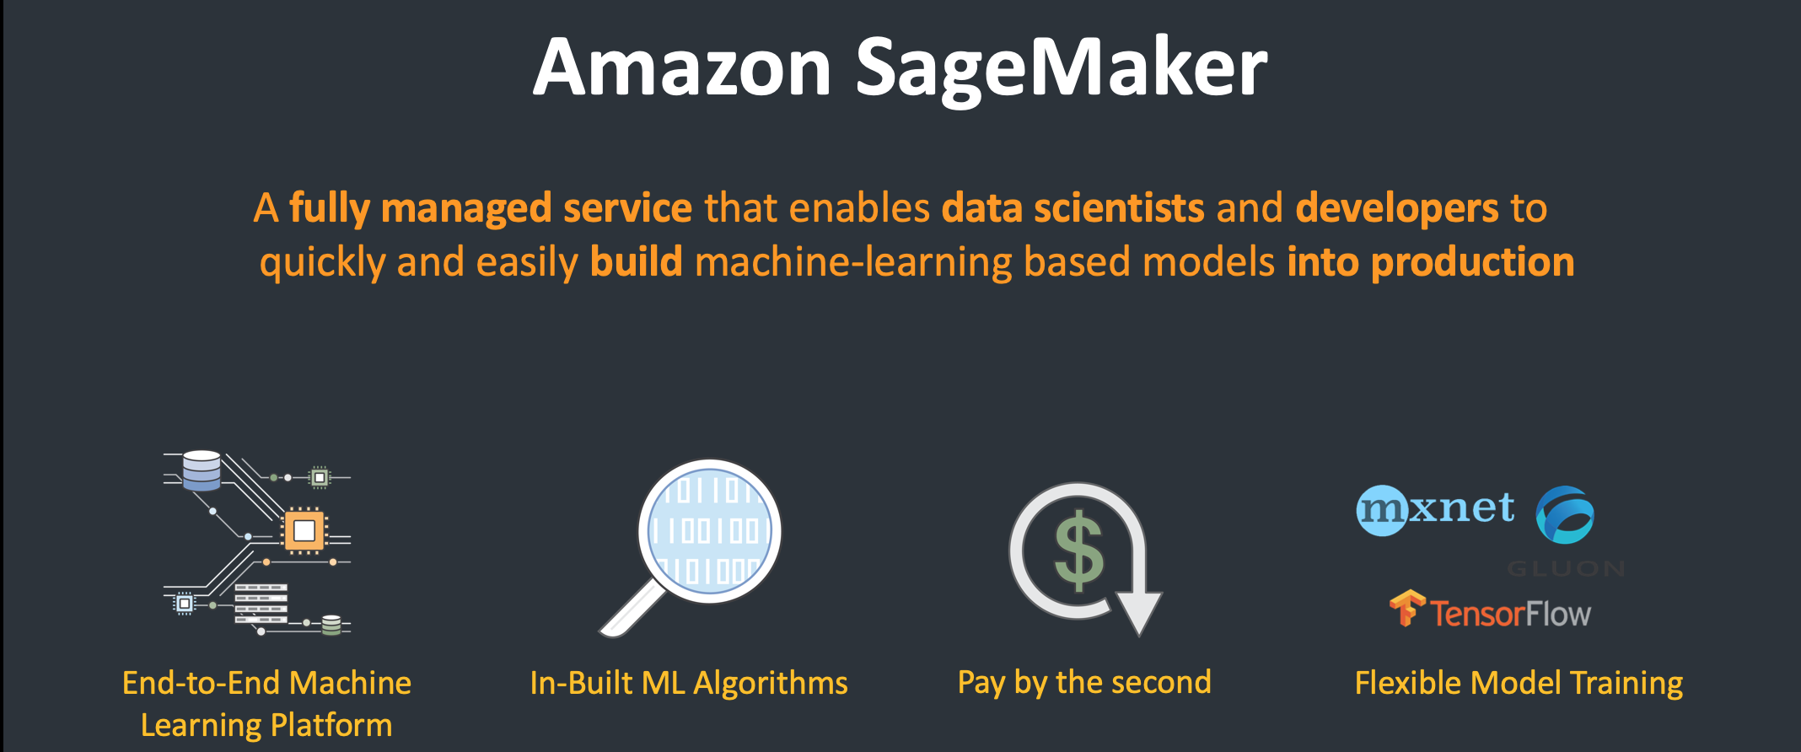

Slide 9
The Machine Learning Process
Business Problem –
ML problem framing
Data Collection
Re-training
Data Integration
Data Augmentation
Data Preparation &
Cleaning
Feature Engineering
Monitoring &
Debugging
Model Training &
Parameter Tuning
Data Visualization &
Analysis
– Predictions
Model Evaluation
Model Deployment
Feature
Augmentation
No
Are Business
Goals met?
Yes

Slide 10
The Data Platform
Business Problem –
ML problem framing
Data Collection
Re-training
Data Integration
Amazon S3
Amazon Glue
Amazon Athena
Amazon EMR
Amazon Redshift
Data Augmentation
Data Preparation &
Cleaning
Feature Engineering
Monitoring &
Debugging
Model Training &
Parameter Tuning
Data Visualization &
Analysis
– Predictions
Model Evaluation
Model Deployment
Feature
Augmentation
No
Are Business
Goals met?
Yes

Slide 11


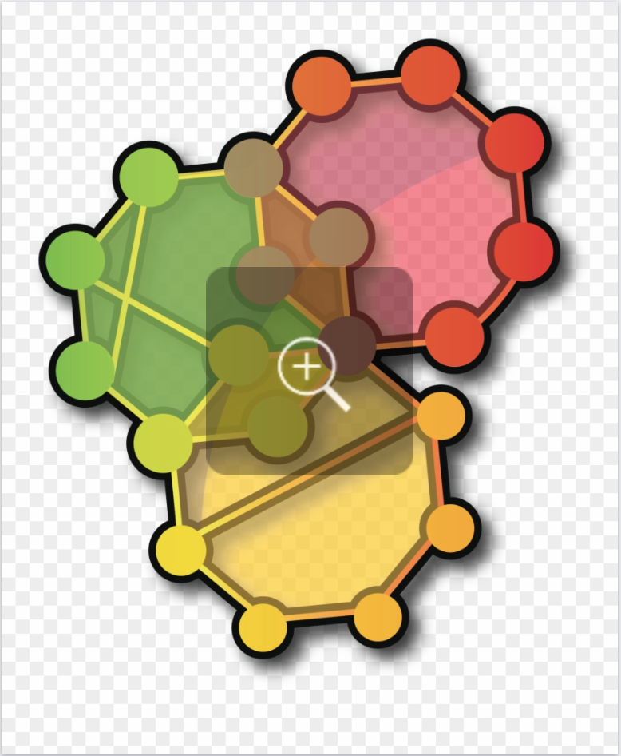
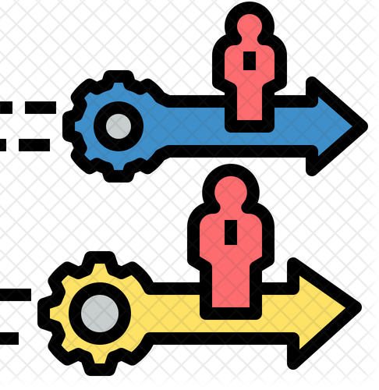

Amazon Sagemaker
1
2
3
4
I
I
I
I
SM Notebooks Service
SM Algorithms
SM Training Service
SM Hosting Service
GPU powered, Workspaces for Data Scientist and Developers
High Performance Web-Scale Algorithms Out Of The Box
Managed Distributed model training service
Production Ready Model Hosting Requiring No Engineering

Slide 12
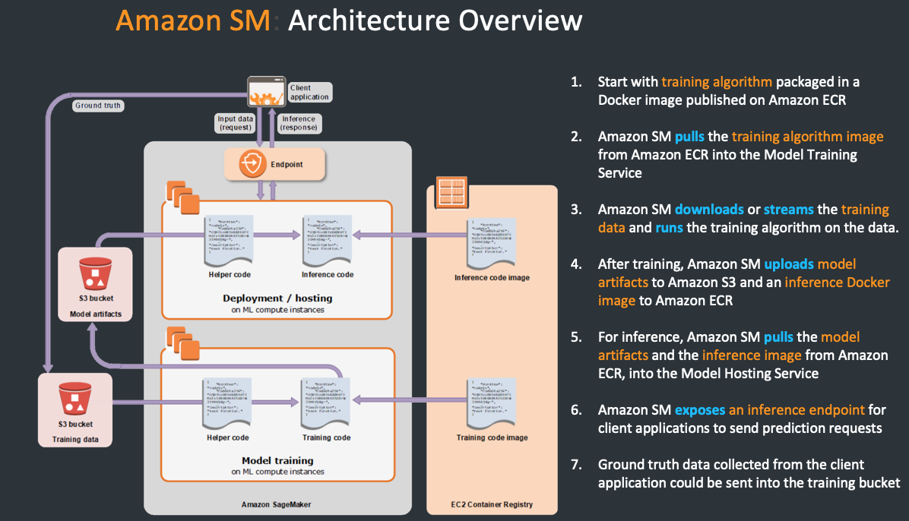

Slide 13
Thank You
more showers soon from multiple clouds !!!

